Slide 1
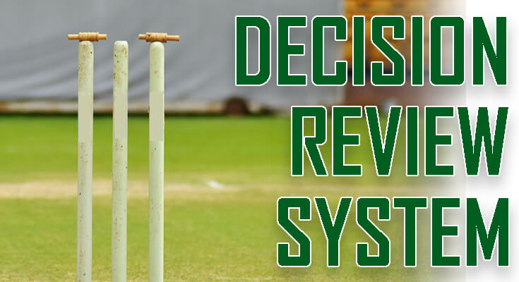
DECISION REVIEW SYSTEM (DRS) Using Python
PRESENTED BY:-
Bhaskar Goel Hardik Sing Ayush Yadav
(1901640100099) (1901640100125) (1901640100094)

Slide 2
What is DRS?
The Decision Review System (DRS) is a technology based system used in cricket to assist the match officials in their decision-making. The addition of Player Reviews and additional technology to this system was first introduced in Test cricket for the sole purpose of reviewing controversial decisions made by the on-field umpires as to whether or not a batsman/batswoman had been dismissed.
On-field umpires may choose to consult with the third umpire, and players may request that the third umpire consider a decision of the on-field umpires.

Slide 3
DECISION REVIEWED BY PLAYER/TEAM
ON FIELD UMPIRE
FINAL DECISION BY THIRD UMPIRE
After the on-field umpire gives his decision, the challenging team has a time of 15 seconds to make its decision if they want to opt for the DRS call or not. The fielding captain or the batsman declared out needs to signal a “T” sign to the onfield-umpire to review the decision.

Slide 4
Software required
VISUAL STUDIO CODE:
Visual Studio Code is a streamlined code editor with support for development operations like debugging, task running, and version control. It aims to provide just the tools a developer needs for a quick code-build-debug cycle and leaves more complex workflows to fuller featured IDEs, such as Visual Studio IDE.

Slide 5
Tools used for DRS
language used->python
MODULES:
TKINTER: Python when combined with Tkinter provides a fast and easy way to create GUI applications. Tkinter provides a powerful object-oriented interface to the Tk GUI toolkit. Import the Tkinter module.
THREADING:The threading module exposes all the methods of the thread module and provides some additional methods − threading. activeCount() − Returns the number of thread objects that are active.
TIME:The Python time module provides many ways of representing time in code, such as objects, numbers, and strings. It also provides functionality other than representing time, like waiting during code execution and measuring the efficiency of your code.
s used to check browser activities. To install this library, type the following command in your terminal.

Slide 6
MODULES:
CV2:OpenCV-Python is a library of Python bindings designed to solve computer vision problems
IMUTILS:A series of convenience functions to make basic image processing functions such as translation, rotation, resizing, skeletonization, and displaying Matplotlib images easier with OpenCV.
FUNCTOOLS: Functools module is for higher-order functions that work on other functions. It provides functions for working with other functions and callable objects to use or extend them without completely rewriting them.

Slide 7
Conclusion
The decision review system has generally received positive responses from players and teams since it launches, because of its positive response many countries are trying to implement a decision review system(DRS) in their games for avoiding controversial decisions

Slide 8
FUTURE SCOPE?
Although the decision review system plays a vital role in-game to avoid controversial decisions taken by on-field umpires but in the future, there should be some updates in Drs like umpires should be given authority to take reviews on their own!. so that even umpire can take review if they are confused enough not to reach on conclusion in case of any decision

Slide 9
THANK YOU.

